Slide 1
SANS in McStas

Slide 2
Agenda
A quick discussion of the SANS technique
Sample models for SANS in McStas

Slide 3
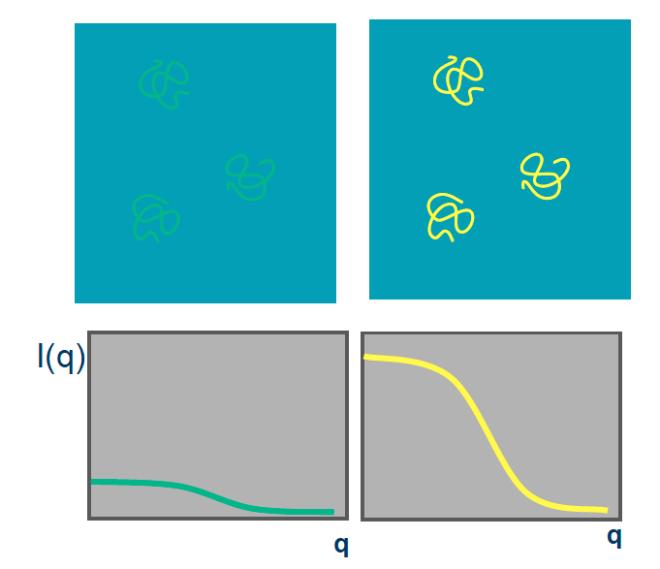
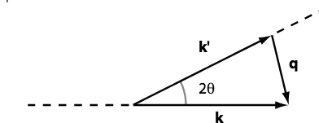
Small angle scattering SANS
SANS method can be used for many types of material
Often: Molecule + Liquid (buffer solution)
Isotropic scattering

Slide 4
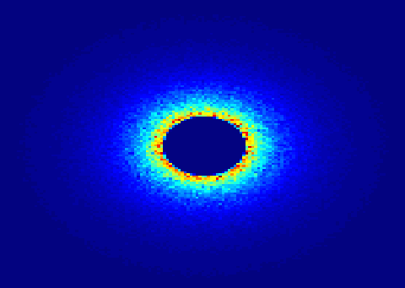
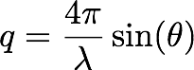
SANS
Small Angle Neutron Scattering
Elastic Scattering
Small angle -> small q -> big r
Gain information on the molecular scale 10-100Å
Low signal to noise
Contrast method
Instrument requirements: good collimation, long flight distance after detector.

Slide 5
McStas has a suite of SANS-models:
Try ellipsoidal and
cylindrical particles
-or-
Elliptic cylinders
Go for Nanodiscs and Liposomes
SANS other samples
SANS_AnySamp.comp
SANS_DebyeS.comp
SANSCylinders.comp
SANSEllipticCylinders.comp
SANSGuinier.comp
SANSLiposomes.comp
SANSNanodiscs.comp
SANSNanodiscsFast.comp
SANSNanodiscsWithTags.
SANSNanodiscsWithTagsFast
SANSPDB.comp
SANSPDBFAST.comp
SANSShells.comp
SANSSpheres.comp
Also – SASmodels from SASview

Slide 6
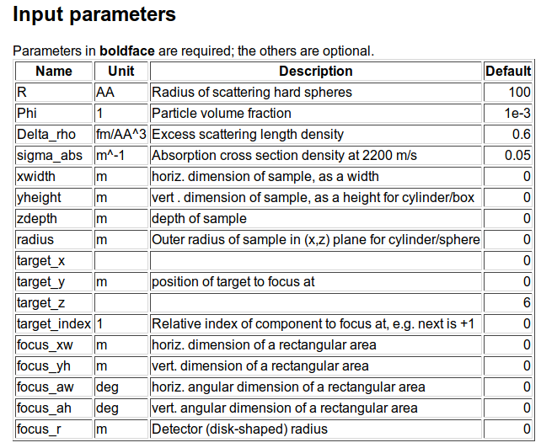
SANS spheres
Dilute, monodisperse, hard spheres in solution, with given contrast and radius

Slide 7
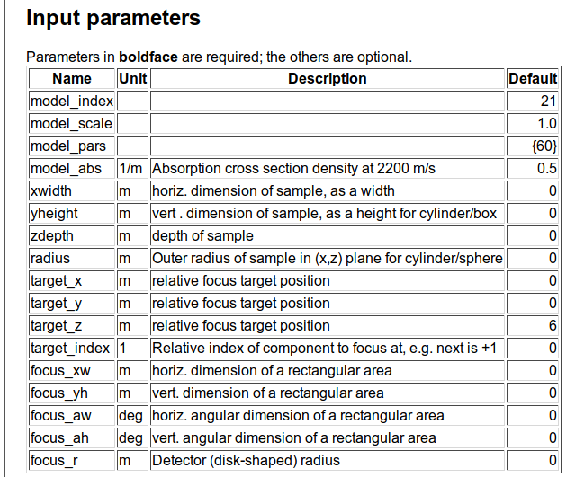
SasView_models

Slide 8
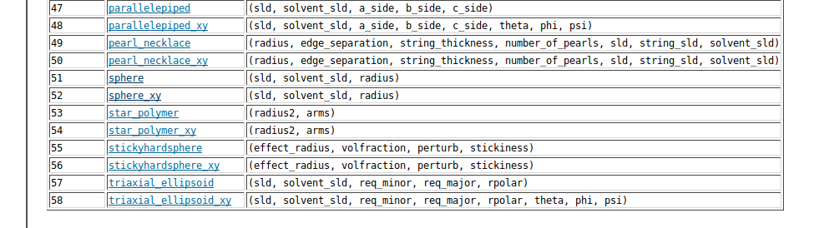
SasView_models

Slide 9
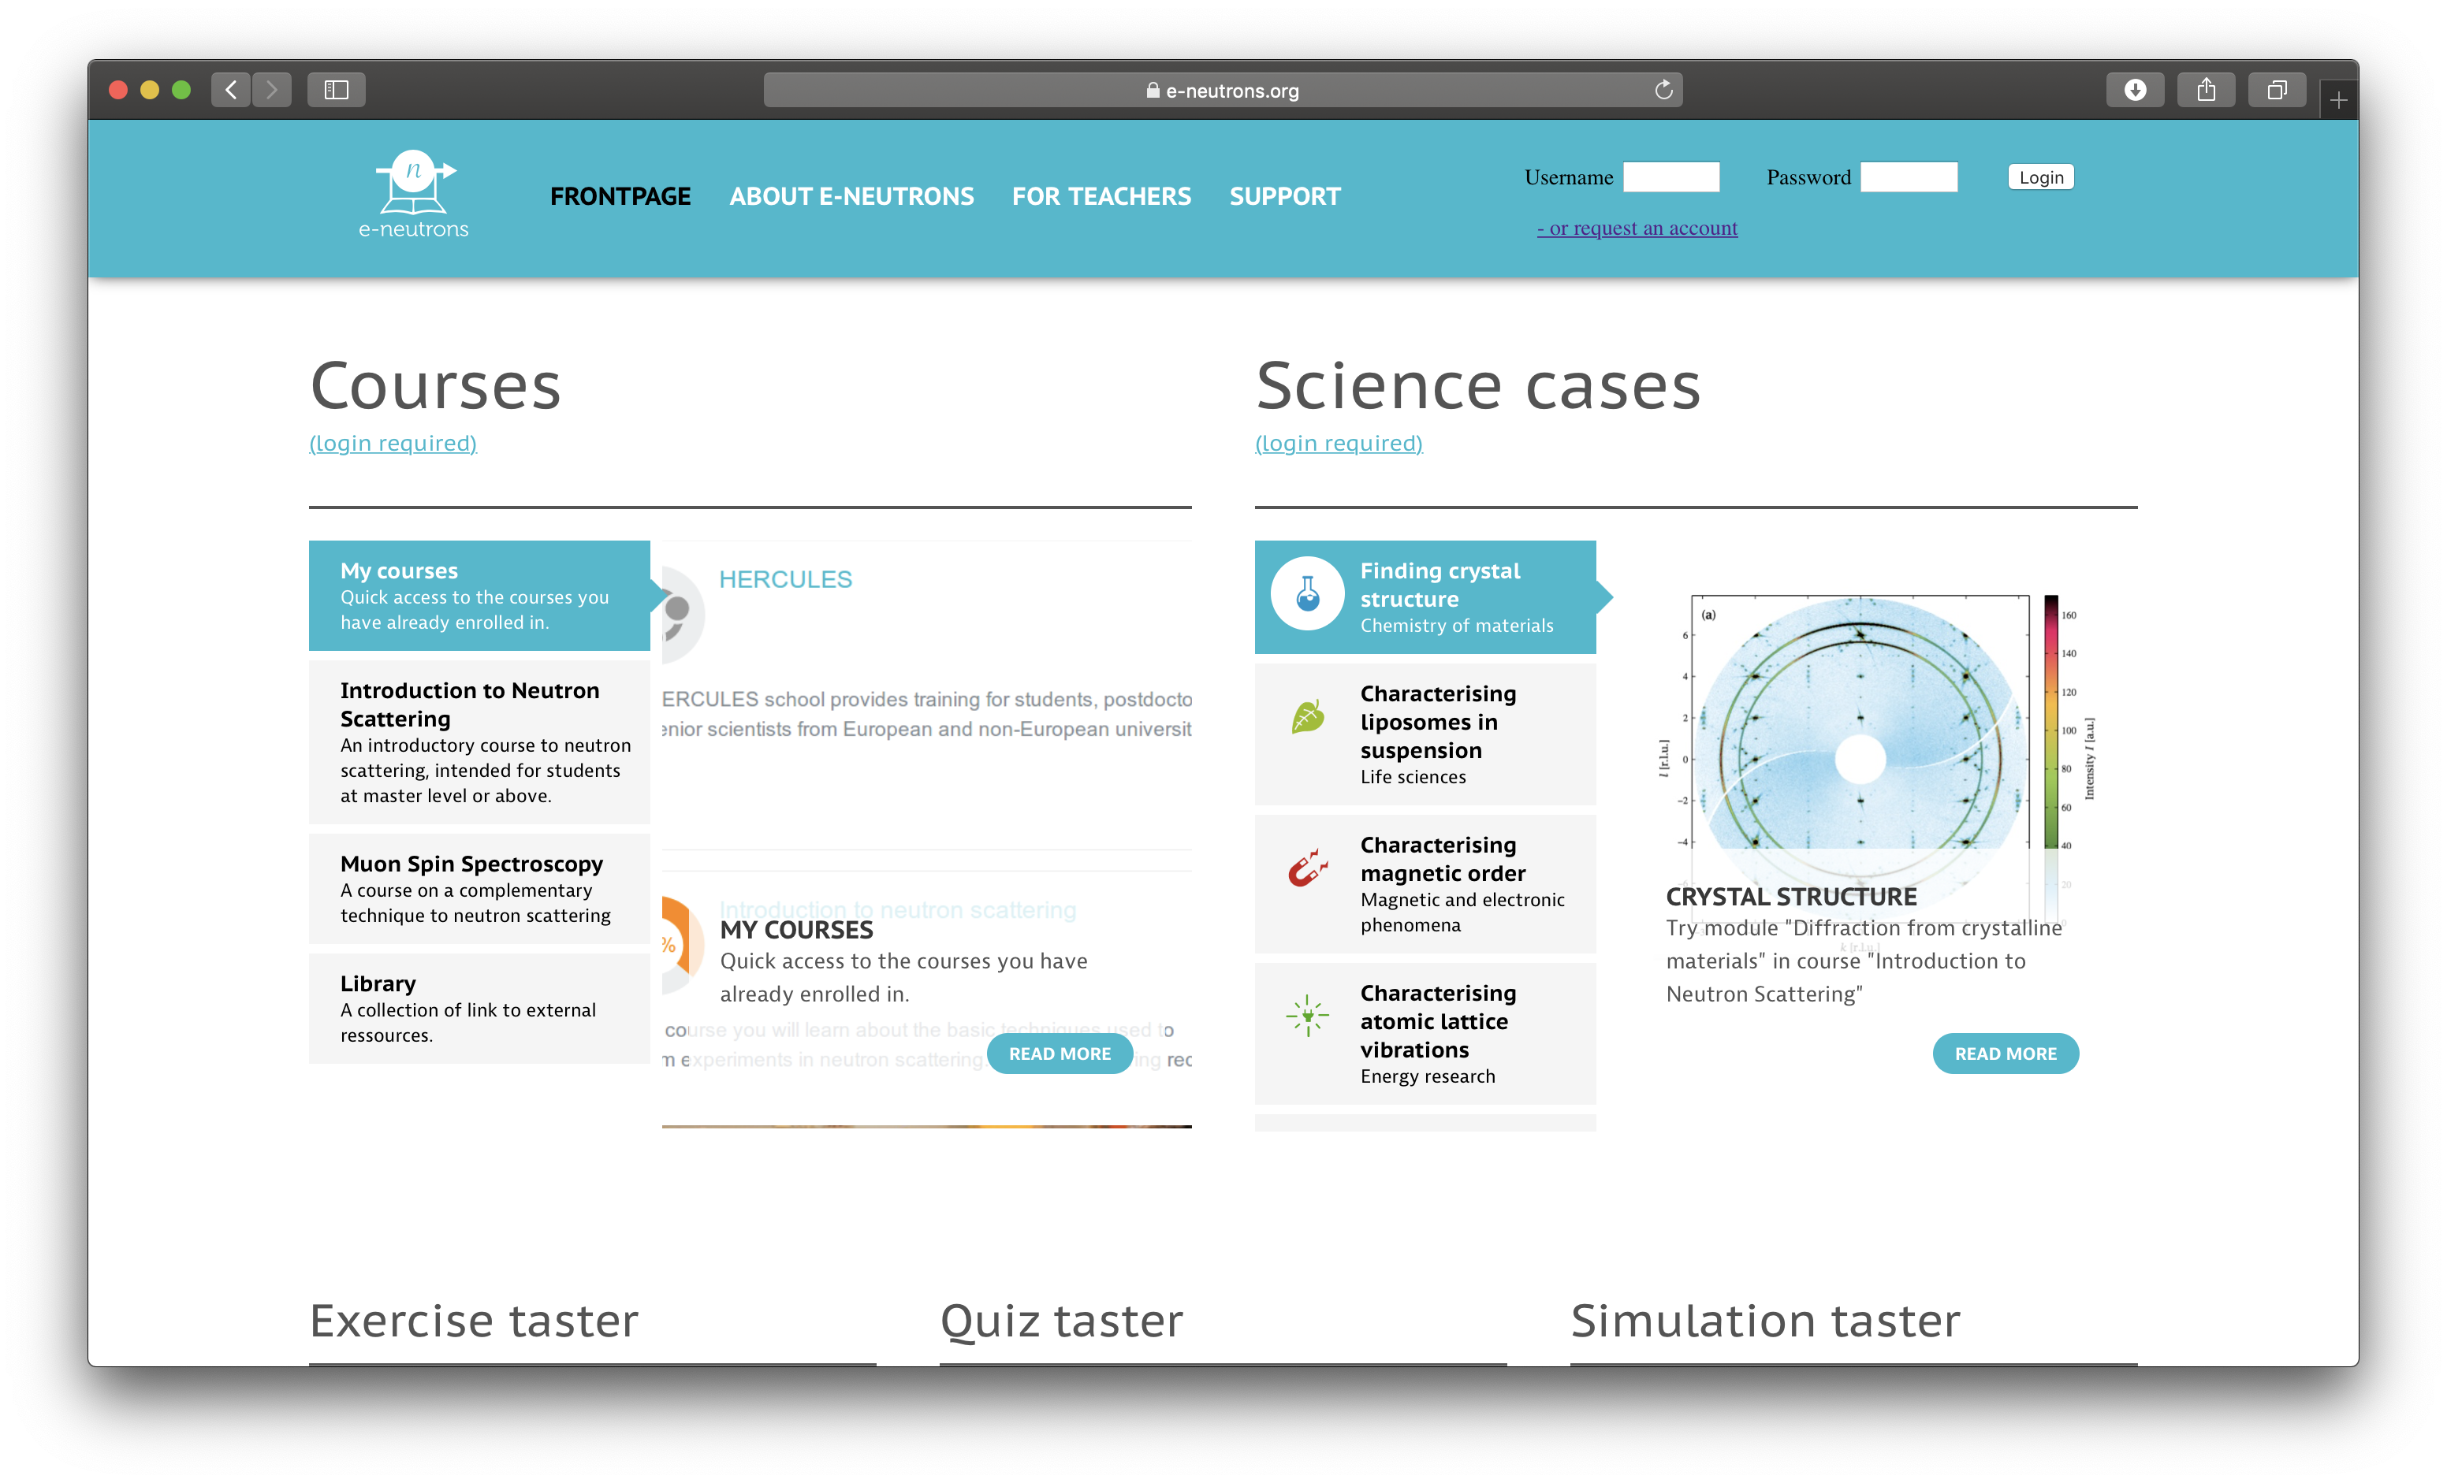
Exercise will take place on the e-neutrons.org infrastructure (using a web-simulator)
Please fill in the form at https://www.e-neutrons.org/?page_id=423
(Once everyone has done this, I will enable the accounts)
You will receive an email with login-credentials
Use these credentials to log in to the simulation quiz at https://www.e-neutrons.org/moodle/mod/quiz/view.php?id=4276
Follow the instructions in the quiz

Slide 10
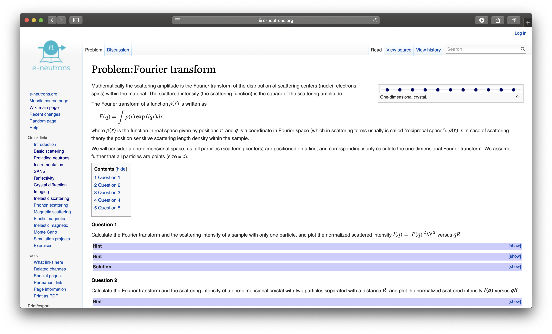

Exercise will take place on the e-neutrons.org infrastructure (using a web-simulator)
Please fill in the form at https://www.e-neutrons.org/?page_id=423
(Once everyone has done this, I will enable the accounts)
You will receive an email with login-credentials
Use these credentials to log in to the simulation quiz at https://www.e-neutrons.org/moodle/mod/quiz/view.php?id=4276
Follow the instructions in the quiz
“Textbook”

Slide 11
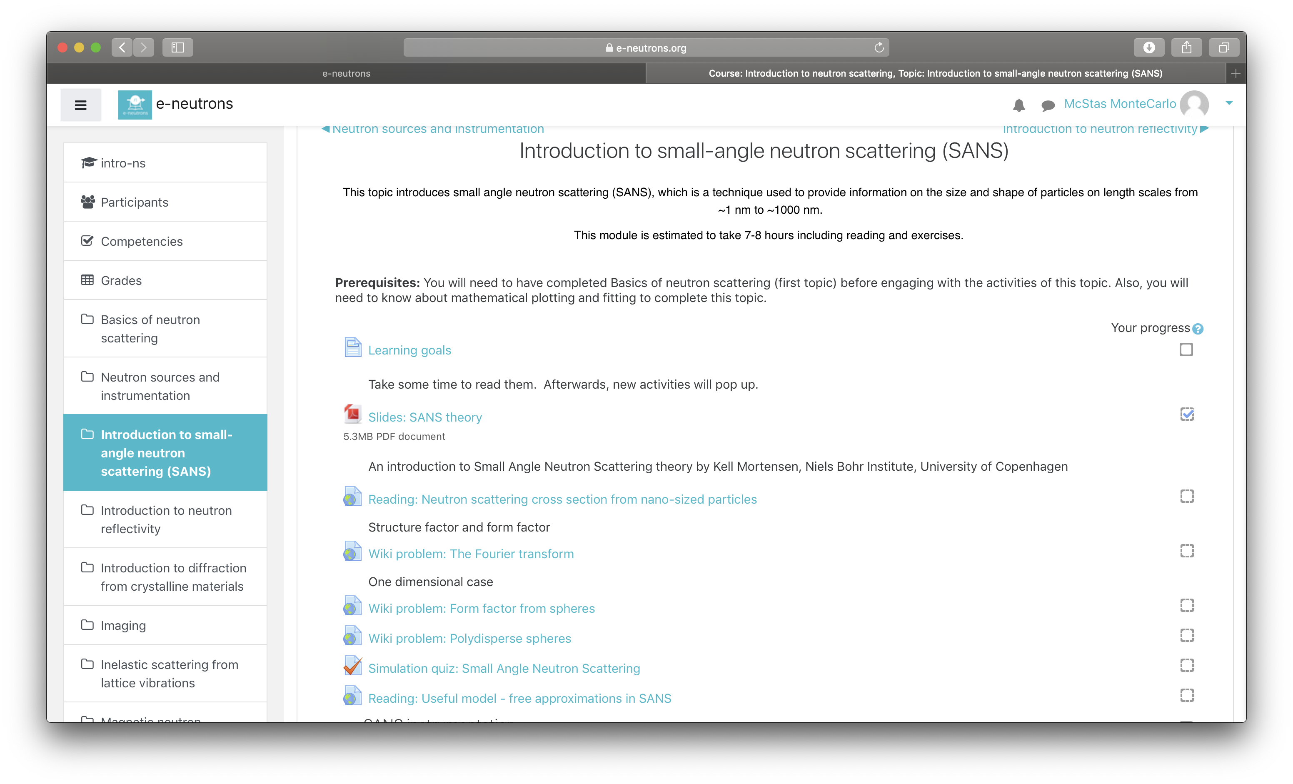

Exercise will take place on the e-neutrons.org infrastructure (using a web-simulator)
Please fill in the form at https://www.e-neutrons.org/?page_id=423
(Once everyone has done this, I will enable the accounts)
You will receive an email with login-credentials
Use these credentials to log in to the simulation quiz at https://www.e-neutrons.org/moodle/mod/quiz/view.php?id=4276
Follow the instructions in the quiz
“Exercises”

Slide 12
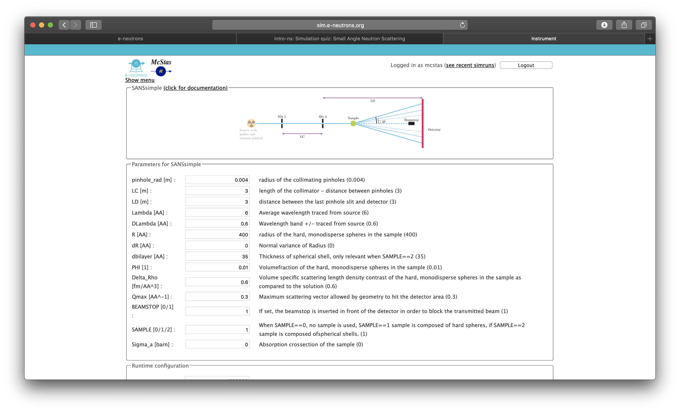

Exercise will take place on the e-neutrons.org infrastructure (using a web-simulator)
Please fill in the form at https://www.e-neutrons.org/?page_id=423
(Once everyone has done this, I will enable the accounts)
You will receive an email with login-credentials
Use these credentials to log in to the simulation quiz at https://www.e-neutrons.org/moodle/mod/quiz/view.php?id=4276
Follow the instructions in the quiz
“Simulator”

Slide 13
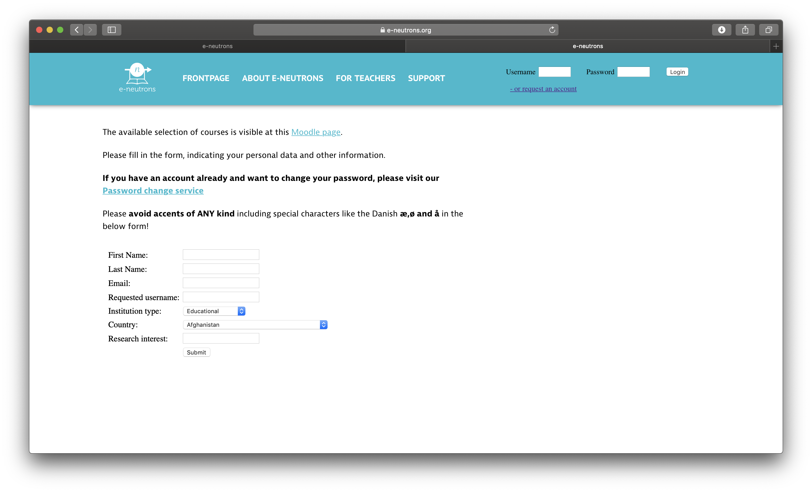
Exercise will take place on the e-neutrons.org infrastructure (using a web-simulator)
Please fill in the form at https://www.e-neutrons.org/?page_id=423
(Once everyone has done this, I will enable the accounts)
You will receive an email with login-credentials
Use these credentials to log in to the simulation quiz at https://www.e-neutrons.org/moodle/mod/quiz/view.php?id=4276
Follow the instructions in the quiz

Slide 14
Exercise will take place on the e-neutrons.org infrastructure (using a web-simulator)
Please fill in the form at https://www.e-neutrons.org/?page_id=423
(Once everyone has done this, I will enable the accounts)
You will receive an email with login-credentials
Use these credentials to log in to the simulation quiz at https://www.e-neutrons.org/moodle/mod/quiz/view.php?id=4276
Follow the instructions in the quiz

Slide 15
Exercise will take place on the e-neutrons.org infrastructure (using a web-simulator)
Please fill in the form at https://www.e-neutrons.org/?page_id=423
(Once everyone has done this, I will enable the accounts)
You will receive an email with login-credentials
Use these credentials to log in to the simulation quiz at https://www.e-neutrons.org/moodle/mod/quiz/view.php?id=4276
Follow the instructions in the quiz
Fallback solution:
Get the PDF and other files from the file ‘fallback.zip’ at https://github.com/McStasMcXtrace/Schools/tree/master/CSNS_March_2019/4_Thursday_March_28th/4_SANS

